Slide 1
Regression and Datamining
By Srinivasu Narahari
ALY-6015 Week 6 Group Project
Professor: Steward Huang

Slide 2
Definitions
Regression: Regression analysis is set of the process used for determining the relation ship between two variables
Classification: In this method classify each item of data into a pre-defined class.
Clustering: The clustering technique defines the classes and puts objects in each class, while in the classification techniques, objects are assigned into predefined classes.
Prediction: Prediction is one pf the data mining technique in this process we discover the relating ships between independent variable and dependent and independent variable.
Sequential Pattern: By using this data mining technique we can find similar patterns or trends or similar events in a transaction data over a business period

Slide 3
Regression Data Set
car_Info_dataset = read.csv(url("http://mlr.cs.umass.edu/ml/machine-learning-databases/autos/imports-85.data"), header=FALSE)
Attribute: Attribute Range :
1. symboling: -3, -2, -1, 0, 1, 2, 3.
2. normalized-losses: continuous from 65 to 256.
3. make:
alfa-romero, audi, bmw, chevrolet, dodge, honda,
isuzu, jaguar, mazda, mercedes-benz, mercury,
mitsubishi, nissan, peugot, plymouth, porsche,
renault, saab, subaru, toyota, volkswagen, volvo
4. fuel-type: diesel, gas.
5. aspiration: std, turbo.
6. num-of-doors: four, two.
7. body-style: hardtop, wagon, sedan, hatchback, convertible.

Slide 4
Algorithm and Summary
model_car_Info_dataset = lm(car_Info_dataset_scrubbed$V1 ~ car_Info_dataset_scrubbed$V2 + car_Info_dataset_scrubbed$V3 + car_Info_dataset_scrubbed$V4 + car_Info_dataset_scrubbed$V5 + car_Info_dataset_scrubbed$V6 + car_Info_dataset_scrubbed$V7)
summary(model_car_Info_dataset)
## Call:
## lm(formula = car_Info_dataset_scrubbed$V1 ~ car_Info_dataset_scrubbed$V2 +
## car_Info_dataset_scrubbed$V3 + car_Info_dataset_scrubbed$V4 +
## car_Info_dataset_scrubbed$V5 + car_Info_dataset_scrubbed$V6 +
## car_Info_dataset_scrubbed$V7)
##
## Residuals:
## Min 1Q Median 3Q Max
## -1.51775 -0.06648 0.00000 0.11599 1.28351
##
## Coefficients:
## Estimate Std. Error t value
## (Intercept) 1.44785 0.57539 2.516

Slide 5
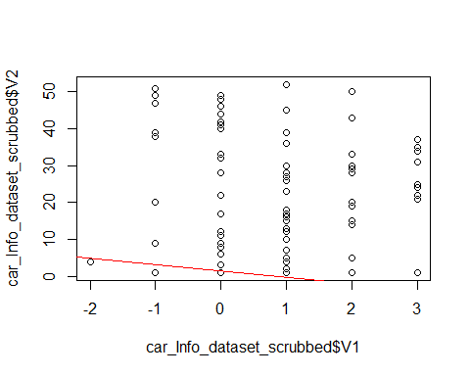
Important Plots in Regression

Slide 6
Classification
Attribute Information:
Class Values:
unacc, acc, good, vgood
Attributes:
buying: vhigh, high, med, low.
maint: vhigh, high, med, low.
doors: 2, 3, 4, 5more.
persons: 2, 4, more.
lug_boot: small, med, big.
safety: low, med, high.

Slide 7
Regression R Formulas
car_Eval_dataset = read.csv(url("http://mlr.cs.umass.edu/ml/machine-learning-databases/car/car.data"), header=FALSE) set.seed(1728) ind <- sample(2, nrow(car_Eval_dataset), replace=T, prob=c(0.7, 0.3)) car_Eval_dataset.train <- car_Eval_dataset[ind==1, ] car_Eval_dataset.test <- car_Eval_dataset[ind==2, ] car_Eval_dataset.formula <- car_Eval_dataset$V1 ~ car_Eval_dataset$V2 + car_Eval_dataset$V3 + car_Eval_dataset$V4 + car_Eval_dataset$V5 + car_Eval_dataset$V6 + car_Eval_dataset$V7 car_Eval_dataset.ctree <- ctree(car_Eval_dataset.formula, data=car_Eval_dataset.train) car_Eval_dataset.ctree

Slide 8
pred <- predict(car_Eval_dataset.ctree, newdata = car_Eval_dataset.test) table(pred, car_Eval_dataset$V2,dnn = c("pred", "V1"))
## V1 ## pred high low med vhigh ## high 296 318 341 240 ## low 62 86 63 72 ## med 0 0 0 0 ## vhigh 74 28 28 120

Slide 9
Conclusion
Conclusion: The points in data set used for regression is complex due to that linear model could not fit all points, I considered both cases of considering single variable and 7 variable cases. In both cases we are getting almost similar values. So, we need to use different algorithm for the regression. In the classification efficiency is coming very low because each class has very less point then actual points. Due to this we need to use another algorithm for the classification

Slide 10
References
References:
Zentut. (n.d.). Data Mining Techniques. Data Mining Techniques. Retrieved from http://www.zentut.com/data-mining/data-mining-techniques/
Zhao, Y. (2015). Introduction to Data Mining with R1. Retrieved from https://docs.google.com/viewerng/viewer?url=http://www.rdatamining.com/docs/RDataMining-introduction-slides.pdf
assambara, A. (2018). Determining The Optimal Number Of Clusters: 3 Must Know Methods . DataNovia. Retrieved from https://www.datanovia.com/en/lessons/determining-the-optimal-number-of-clusters-3-must-know-methods/
NEU. (2019). MPSA - ALY6015 Intermediate Analytics - V1. Retrieved from https://northeastern.acrobatiq.com/courseware/glossary/NEU_MPSA_INTERMEDIATE_ANALYTICS_ALY6015_V1_23
Maindonald, J. H. (2008, January 19). Using R for Data Analysis and Graphics . Introduction, Code and Commentary . Retrieved from https://cran.r-project.org/doc/contrib/usingR.pdf

